Slide 1
Recitation#2
TA: Tatheer Zahra (tzz5184@psu.edu)

Slide 2
Important Announcements
Grades for L.5 have been uploaded.
L.6 and A.1 is due this Friday. Submissions after 5 will have a 10% deduction.
Please check Canvas for announcements from Dan Kahn.
Invalid Teams for A.1

Slide 3
Feedback from L.5
Usage of built-in functions.
Name your files correctly and include header as well.
Nested constructs (loop within loop).
Changing the original list.
Follow the instructions from the lab description.

Slide 4
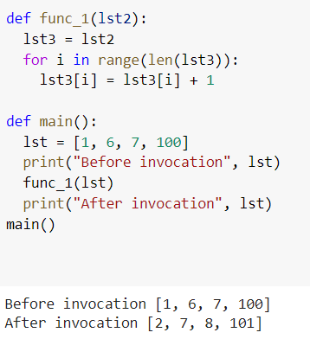
Feedback from L.5
Copying the original list – incorrect

Slide 5
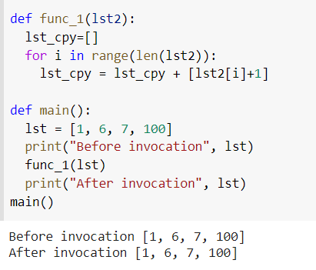
Feedback from L.5
Copying the original list - correct way:

Slide 6
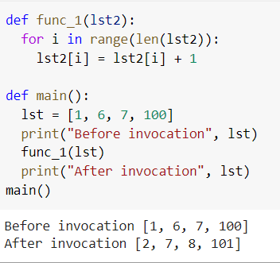
Feedback from L.5
Changing the original list – incorrect if we ask you to not modify it. Correct way if we ask you to modify or change the original list.

Slide 7
Review on Module 2
What is recursion?
A function calling itself
Steps in recursion:
Recursive call
Base case
Dividing your problems into subproblems
What is stack and LIFO?
What happens when stack gets full?
Stack overflow

Slide 8
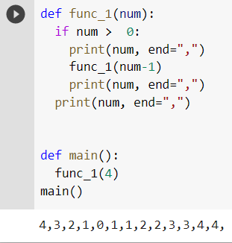
Practice Problem#1

Slide 9
Practice Problem#2
Write a function called factorial that takes a number n and finds the factorial of it.
Formula for factorial:
fact = num*(num-1)*(num-2)*(num-3)………1

Slide 10
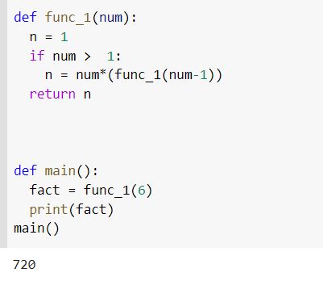
Practice Problem#2

Slide 11
Prepare for timed test
Sign into canvas and pull up the recitation page on the lab computer ​​
Clear workspace (no notes, no phones, all away)​
You will hear me call out time warnings. Please manage your time!​​
Raise your hand if you have any questions ​​
Remember this timed test only covers material from Modules 5.
Can refer to Syllabus “Important” section for prohibited constructs​
Don’t need comment header or specific file name (only for lab assignments)​
When you are done, take a picture of your submission page and sign out with the LA at the front.

Slide 12
Timed Test
Time test will be due in 30 minutes​​. You should mark your attendance after 30 minutes to be considered for grading.
Read the instructions carefully.
If you have a question, raise your hands.
Password: alwaysPOsITiVe+

